Slide 1
Military – Credit for Prior Learning
Susan Barbitta
barbittas@nccommunitycolleges.edu
10-2018
This Photo by Unknown Author is licensed under CC BY-SA

Slide 2
U.S. Military Personnel Active Duty: 1,296,900 National Guard: 448,700 Selected Reserve: 364,500 TOTAL: 2,110,100

Slide 3
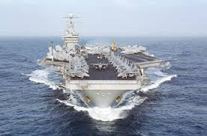
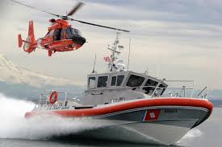
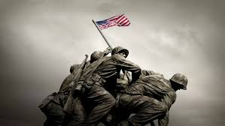
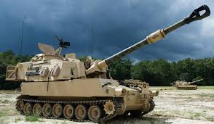
Active Duty
1,296,000

Slide 4
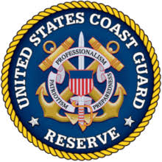
448,700
364,500
Total: 2,110,100 (end of 2017)
Notes:
Over 200 Army MOSs
Over 100 Navy enlisted rates
Air Force – over 150 career fields
Marines – over 300 MOSs in 35 fields
Coast Guard – over 20 occupations

Slide 5
Faculty Panels
American Council on Education (ACE)
SACSCOC
Joint Services Transcript (JST)

Slide 6
NURSING
AUTOMOTIVE
AVIATION
RAD TECH
SURGICAL TECH
DENTAL
SUPPLY CHAIN MANAGEMENT
CONSTRUCTION
BUSINESS
COMPUTER SCIENCE & IT
FOREIGN LANGUAGE
CRIMINOLOGY & CJ
EMS/EMT
COMMUNICATIONS & ENGLISH
HUMANITIES
EDUCATION
Over 100 skill levels and courses evaluated
Faculty members have recommended the awarding of approximately 4,000 semester credit hours

Slide 7
Next Steps
Website
Joint UNC & Community College System
Consistent transcripting
Additional Faculty Panel Evaluations

Slide 8
Susan Barbitta
barbittas@nccommunitycolleges.edu
10-2018
This Photo by Unknown Author is licensed under CC BY-SA

