Slide 1
Online Learning Trends and Analysis

Slide 2
Fall Curriculum FTE by Instructional Method

Slide 3
Online Enrollment of Fall 17 Curriculum Students

Slide 4
Credit Hour Enrollment of Fall 17 Curriculum Students

Slide 5
Credit Hour Enrollment of Fall 17 Curriculum Students

Slide 6
In Fall 2017, there were 2674 unique curriculum courses (i.e. ENG-111) taught in the North Carolina Community College System

Slide 7
1139 courses were offered in an online format
In Fall 2017, there were 2674 unique curriculum courses (i.e. ENG-111) taught in the North Carolina Community College System
43%

Slide 8
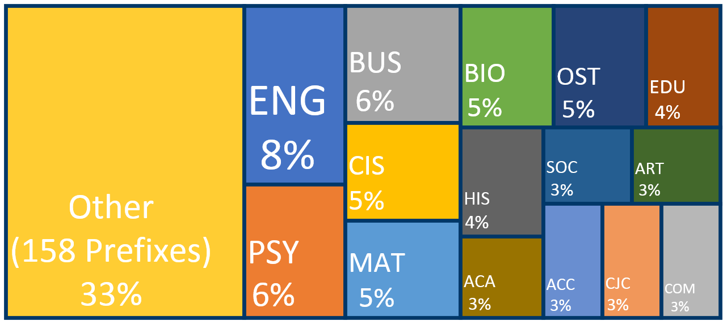
Online Fall 17 Curriculum FTE Share by Prefix

Slide 9
51 courses are offered online by all or a majority of community colleges

Slide 10
Fall 17 Grade Distribution by Instructional Method

Slide 11
Questions

